Slide 1
NHS WIGAN BOROUGH CCG
Latest survey results
January 2016 publication

Slide 2
Contents
66
This slide pack provides results for the following topic areas:
Background, introduction and guidance.….…………………….……………………………………………..Slide 3
Overall experience of GP surgeries……………………………………………………………………………...Slide 8
Access to GP services………..……………………………………………………………………………………Slide 14
Making an appointment…………………………………………………………………………………………….Slide 23
Waiting times at the GP surgery.….…………………………………………………………………………......Slide 34
Perceptions of care at patients’ last GP appointment………………………………………………….........Slide 38
Perceptions of care at patients’ last nurse appointment………………………………………………….…Slide 43
Satisfaction with the practice’s opening hours.……………………………………………………………….Slide 48
Out-of-hours services.…………………………………………………………………………………………...…Slide 52
Statistical reliability..………………………………………………………………………………………………..Slide 56
Want to know more?………………………………………………………………………………………………..Slide 58

Slide 3
Background, introduction and guidance

Slide 4
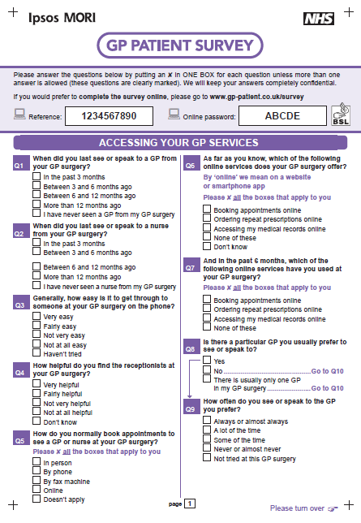
Background information about the survey
The GP Patient Survey (GPPS) is an England-wide survey, providing practice-level data about patients’ experiences of their GP practices.
Ipsos MORI administers the survey on behalf of NHS England.
For more information about the survey please refer to the end of this slide pack or visit https://gp-patient.co.uk/.
This slide pack presents some of the key results for NHS WIGAN BOROUGH CCG.
The data in this slide pack are based on the January 2016 GPPS publication. This combines two waves of fieldwork, from January to March 2015 and July to September 2015, providing practice-level data.
In NHS WIGAN BOROUGH CCG, 20,011 questionnaires were sent out, and 6,987 were returned completed. This represents a response rate of 35%.
Prior to 2015 these slide packs presented Area Team averages for each CCG. These are no longer included following the integration of Area Teams into the four existing Regional Teams. However, CCGs can still see how their results compare to those of other local CCGs.

Slide 5
Introduction
The GP Patient Survey measures patients’ experiences across a range of topics, including:
  Making appointments
  Waiting times
  Perceptions of care at appointments
  Practice opening hours
  Out-of-hours services
The GP Patient Survey provides data at practice level using a consistent methodology, which means it is comparable across organisations and over time.
The survey has limitations:
  Sample sizes at practice level are relatively small.
  The survey does not include qualitative data which limits the detail provided by the results.
  The data are provided twice a year rather than in real time.
However, given the consistency of the survey across organisations and over time, GPPS can be used as one element of evidence.
It can be triangulated with other sources of feedback, such as feedback from Patient Participation Groups, local surveys and the Friends and Family Test, to develop a fuller picture of patient journeys.
This slide pack is intended to assist this triangulation of data. It aims to highlight where there may be a need for further exploration.
Practices and CCGs can then discuss the findings further and triangulate them with other data – in order to identify potential improvements and highlight best practice.
The following slide suggests ideas for how the data can be used to improve services.

Slide 6
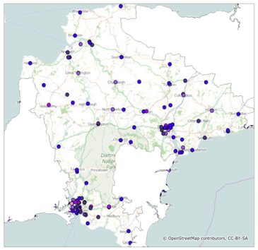
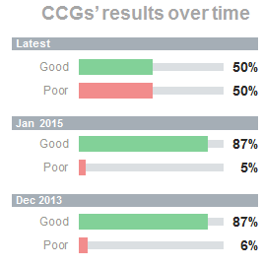
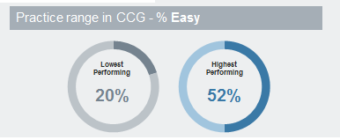
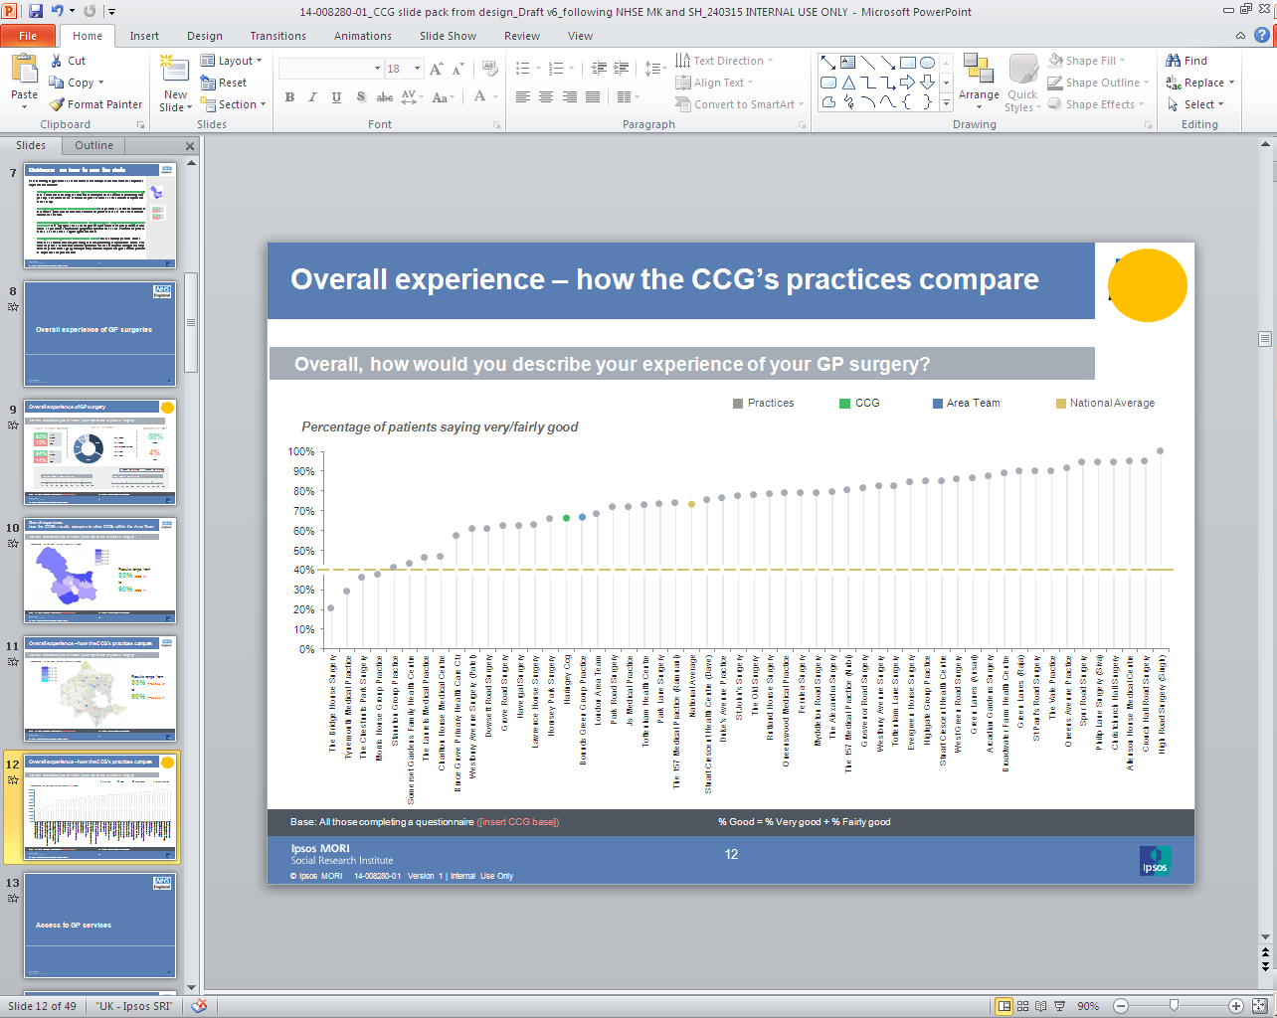
Guidance on how to use the data
The following suggest ideas for how the data in this slide pack can be used and interpreted to improve GP services:
  Comparison of a CCG’s results against the national average: this allows benchmarking of the results to identify whether the CCG is performing well, poorly, or in line with others. The CCG may wish to focus on areas where it compares less favourably.
  Analysing trends in a CCG’s results over time: this provides a sense of the direction of the CCG’s performance over time. The CCG may wish to focus on areas that have seen declines over time.
  Considering questions where there is a larger range in responses among practices or CCGs: this highlights areas in which greater improvements may be possible, as some CCGs or practices are performing significantly better than others nearby. The CCG may wish to focus on areas with a larger range in the results.
  Comparison of practices’ results within a CCG: this can identify practices within a CCG that seem to be over-performing or under-performing compared with others. The CCG may wish to work with individual practices: those that are performing particularly well may be able to highlight best practice, while those performing less well may be able to improve their performance.

Slide 7
Interpreting the results
*
More than 0% but less than 0.5%
The number of respondents answering (the base size) is stated for each question. The total number of responses is shown at the bottom of each chart.
All comparisons are indicative only. Differences may not be statistically significant – particularly when comparing practices due to low numbers of responses.
For guidance on statistical reliability, or for details of where you can get more information about the survey, please refer to the end of this slide pack.
Maps:
  CCG and practice-level results are also displayed on maps, with results split across 5 bands (or ‘quintiles’) in order to have a fairly even distribution at the national level of CCGs/practices across each band.
Trends:
  Latest / Jan 2016: refers to the January 2016 publication (fieldwork January to March 2015 and July to September 2015)
  Jan 2015: refers to the January 2015 publication (fieldwork January to March 2014 and July to September 2014).
  Dec 2013: refers to the December 2013 publication (fieldwork January to March 2013 and July to September 2013).
For further information on using the data please refer to the end of this slide pack.
When fewer than 10 patients respond
In cases where fewer than 10 people have answered a question, the data have been suppressed and results will not appear within the charts. This is to prevent individuals and their responses being identifiable in the data.
100%
Where results do not sum to 100%, or where individual responses (e.g. fairly good; very good) do not sum to combined responses
(e.g. very/fairly good) this is due to rounding.

Slide 8
Overall experience of GP surgeries

Slide 9
Overall experience of GP surgery
Overall, how would you describe your experience of your GP surgery?
CCG’s results over time
CCG’s results
National results
85%
Latest
Good
Jan 2015
5%
Dec 2013
Poor
Practice range in CCG – % Good
Local CCG range – % Good
Lowest Performing |  | Highest Performing
71% |  | 99%
Lowest Performing |  | Highest Performing
81% |  | 89%
Base: All those completing a questionnaire: National (836,967); CCG 2016 (6,855); CCG 2015 (7,226); CCG 2013 (7,546) Practice bases range from 48 to 129; CCG bases range from 1,444 to 6,855
%Good = %Very good + %Fairly good
%Poor = %Very poor + %Fairly poor

Slide 10
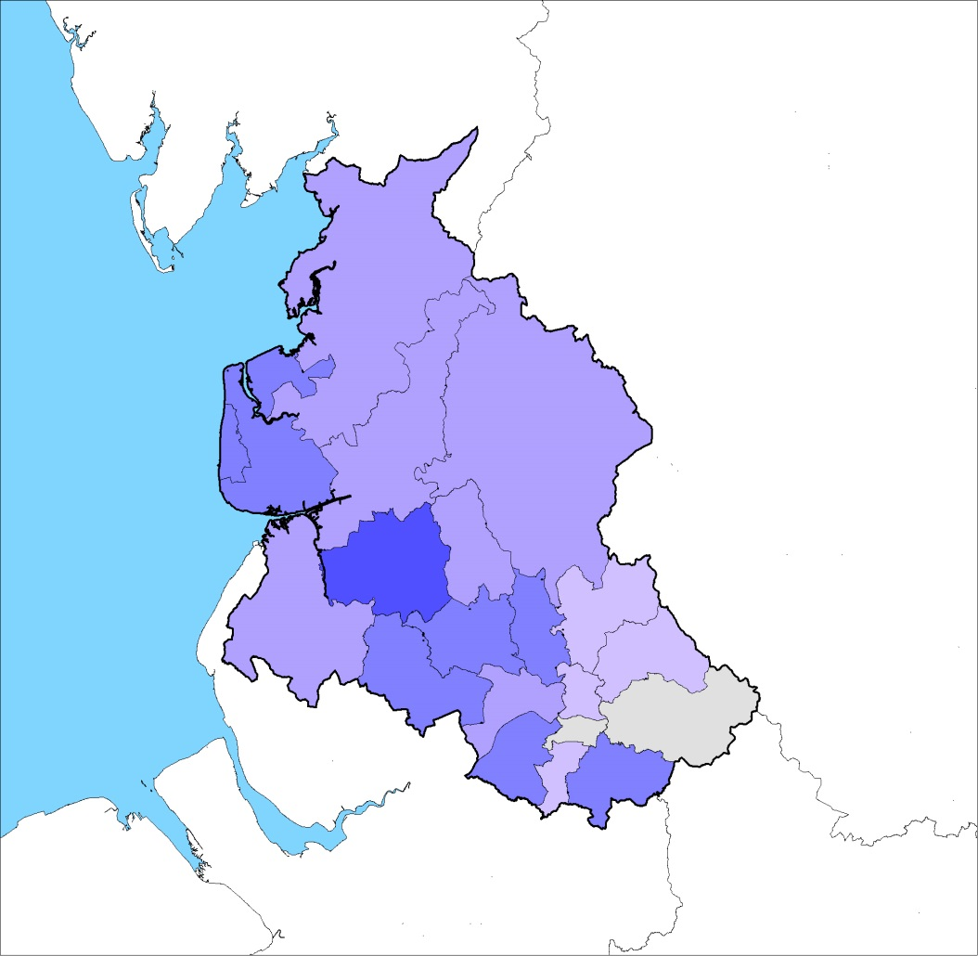
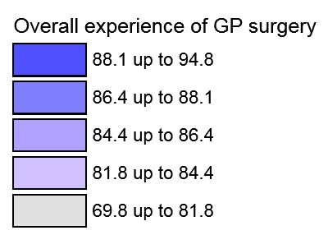
Overall experience: how the CCG’s results compare to other local CCGs
Overall, how would you describe your experience of your GP surgery?
Percentage of patients saying good
Results range from
to
81%
89%
90%
Comparisons are indicative only: differences may not be statistically significant
Base: All those completing a questionnaire: CCG bases range from 1,444 to 6,855
Base: All those completing a questionnaire : CCC bases range from [insert smallest CCG base] to [insert largest CCG base]
%Good = %Very good + %Fairly good

Slide 11
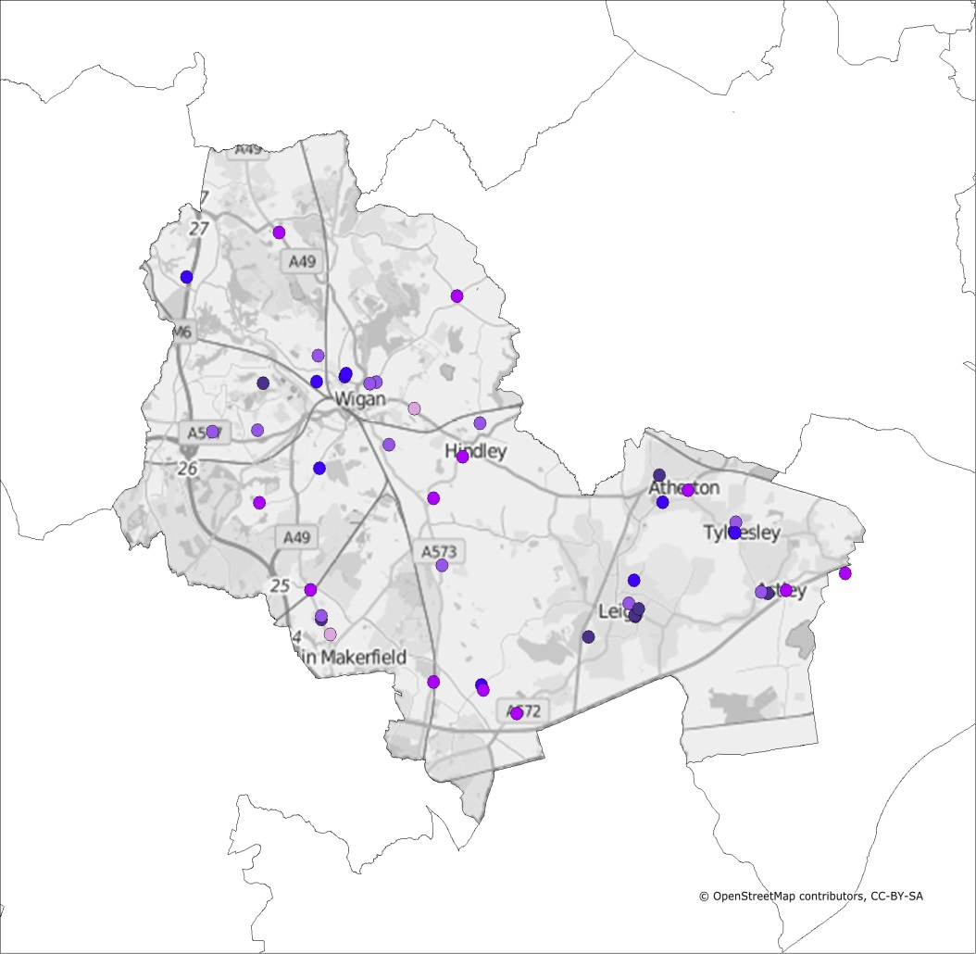
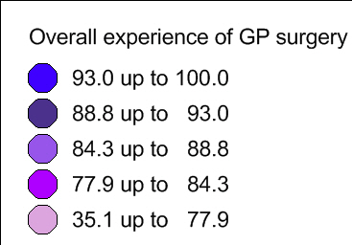
Overall experience – how the CCG’s practices compare
Overall, how would you describe your experience of your GP surgery?
Percentage of patients saying good
Results range from
to
71%
99%
83% | (Practice X)
Comparisons are indicative only: differences may not be statistically significant
Base: All those completing a questionnaire: Practice bases range from 48 to 129
Base: All those completing a questionnaire : Practice bases range from [insert smallest Practice base] to [insert largest Practice base]
%Good = %Very good + %Fairly good

Slide 12
Overall experience – how the CCG’s practices compare
Overall, how would you describe your experience of your GP surgery?
Percentage of patients saying good
Practices
CCG
National Average
Comparisons are indicative only: differences may not be statistically significant, particularly at practice level due to low numbers of responses
Base: All those completing a questionnaire: National (836,967); CCG (6,855); Practice bases range from 48 to 129
%Good = %Very good + %Fairly good
Base: All those completing a questionnaire : Practice bases range from [insert smallest Practice base] to [insert largest Practice base]

Slide 13
Overall experience – how the CCG’s practices compare
Overall, how would you describe your experience of your GP surgery?
Percentage of patients saying good
Practices
CCG
National Average
Comparisons are indicative only: differences may not be statistically significant, particularly at practice level due to low numbers of responses
Base: All those completing a questionnaire: National (836,967); CCG (6,855); Practice bases range from 48 to 129
%Good = %Very good + %Fairly good
Base: All those completing a questionnaire : Practice bases range from [insert smallest Practice base] to [insert largest Practice base]

Slide 14
Access to GP services

Slide 15
Ease of getting through to GP surgery on the phone
Generally, how easy is it to get through to someone at your GP surgery on the phone?
CCG’s results over time
CCG’s results
National results
70%
Latest
Easy
Jan 2015
26%
Dec 2013
Not easy
Practice range in CCG - % Easy
Local CCG range - % Easy
Lowest Performing |  | Highest Performing
46% |  | 99%
Lowest Performing |  | Highest Performing
57% |  | 77%
Base: All those completing a questionnaire: National (849,770); CCG 2016 (6,962); CCG 2015 (7,350); CCG 2013 (7,716) Practice bases range from 48 to 130; CCG bases range from 1,457 to 6,962
%Easy = %Very easy + %Fairly easy
%Not easy = %Not very easy + %Not at all easy

Slide 16
Ease of getting through to GP surgery on the phone: how the CCG’s practices compare
Generally, how easy is it to get through to someone at your GP surgery on the phone?
Practices
CCG
National Average
Percentage of patients saying it is ‘easy’ to get through to someone on the phone
Comparisons are indicative only: differences may not be statistically significant, particularly at practice level due to low numbers of responses
Base: All those completing a questionnaire: National (849,770); CCG (6,962); Practice bases range from 48 to 130
Base: All those completing a questionnaire : Practice bases range from [insert smallest Practice base] to [insert largest Practice base]
%Easy = %Very easy + %Fairly easy

Slide 17
Ease of getting through to GP surgery on the phone: how the CCG’s practices compare
Generally, how easy is it to get through to someone at your GP surgery on the phone?
Practices
CCG
National Average
Percentage of patients saying it is ‘easy’ to get through to someone on the phone
Comparisons are indicative only: differences may not be statistically significant, particularly at practice level due to low numbers of responses
Base: All those completing a questionnaire: National (849,770); CCG (6,962); Practice bases range from 48 to 130
Base: All those completing a questionnaire : Practice bases range from [insert smallest Practice base] to [insert largest Practice base]
%Easy = %Very easy + %Fairly easy

Slide 18
Helpfulness of receptionists at GP surgery
How helpful do you find the receptionists at your GP surgery?
CCG’s results over time
CCG’s results
National results
87%
Latest
Helpful
Jan 2015
11%
Dec 2013
Not helpful
Practice range in CCG - % Helpful
Local CCG range - % Helpful
Lowest Performing |  | Highest Performing
80% |  | 100%
Lowest Performing |  | Highest Performing
84% |  | 90%
Base: All those completing a questionnaire: National (849,199); CCG 2016 (6,950); CCG 2015 (7,351); CCG 2013 (7,719) Practice bases range from 48 to 130; CCG bases range from 1,454 to 6,950
%Helpful = %Very helpful + %Fairly helpful
%Not helpful = %Not very helpful + %Not at all helpful

Slide 19
Helpfulness of receptionists at GP surgery: how the CCG’s practices compare
How helpful do you find the receptionists at your GP surgery?
Practices
CCG
National Average
Percentage of patients saying receptionists at the GP surgery are ‘helpful’
Comparisons are indicative only: differences may not be statistically significant, particularly at practice level due to low numbers of responses
Base: All those completing a questionnaire: National (849,199); CCG (6,950); Practice bases range from 48 to 130
Base: All those completing a questionnaire : Practice bases range from [insert smallest Practice base] to [insert largest Practice base]
%Helpful = %Very helpful + %Fairly helpful

Slide 20
Helpfulness of receptionists at GP surgery: how the CCG’s practices compare
How helpful do you find the receptionists at your GP surgery?
Practices
CCG
National Average
Percentage of patients saying receptionists at the GP surgery are ‘helpful’
Comparisons are indicative only: differences may not be statistically significant, particularly at practice level due to low numbers of responses
Base: All those completing a questionnaire: National (849,199); CCG (6,950); Practice bases range from 48 to 130
Base: All those completing a questionnaire : Practice bases range from [insert smallest Practice base] to [insert largest Practice base]
%Helpful = %Very helpful + %Fairly helpful

Slide 21
Awareness of online services
As far as you know, which of the following online services does your GP surgery offer?
Practice range within CCG
Percentage aware of online services offered by GP surgery
Comparisons are indicative only: differences may not be statistically significant
Base: All those completing a questionnaire: National (823,614); CCG (6,758); Practice bases range from 45 to 126

Slide 22
Online service use
And in the past 6 months, which of the following online services have you used at your GP surgery?
Practice range within CCG
Percentage used online services in past 6 months
Comparisons are indicative only: differences may not be statistically significant
Base: All those completing a questionnaire: National (823,965); CCG (6,733); Practice bases range from 46 to 128

Slide 23
Making an appointment

Slide 24
Success in getting an appointment
The last time you wanted to see or speak to a GP or nurse, were you able to get an appointment to see or speak to someone?
CCG's results over time
CCG’s results
National results
85%
Latest
Yes
Jan 2015
11%
Dec 2013
No
Practice range in CCG - % Yes
Local CCG range - % Yes
Lowest Performing |  | Highest Performing
68% |  | 99%
Lowest Performing |  | Highest Performing
80% |  | 88%
Base: All those completing a questionnaire: National (815,057); CCG 2016 (6,678); CCG 2015 (7,157); CCG 2013 (7,470) Practice bases range from 46 to 130; CCG bases range from 1,397 to 6,678
%Yes = %Yes + %Yes, but I had to call back closer to or on the day

Slide 25
Success in getting an appointment: how the CCG’s practices compare
The last time you wanted to see or speak to a GP or nurse, were you able to get an appointment to see or speak to someone?
Practices
CCG
National Average
Percentage of patients who said they were able to get an appointment last time they tried to see or speak to a GP or nurse
Comparisons are indicative only: differences may not be statistically significant, particularly at practice level due to low numbers of responses
Base: All those completing a questionnaire: National (815,057); CCG (6,678); Practice bases range from 46 to 130
%Yes = %Yes + %Yes, but I had to call back closer to or on the day
Base: All those completing a questionnaire : Practice bases range from [insert smallest Practice base] to [insert largest Practice base]

Slide 26
Success in getting an appointment: how the CCG’s practices compare
The last time you wanted to see or speak to a GP or nurse, were you able to get an appointment to see or speak to someone?
Practices
CCG
National Average
Percentage of patients who said they were able to get an appointment last time they tried to see or speak to a GP or nurse
Comparisons are indicative only: differences may not be statistically significant, particularly at practice level due to low numbers of responses
Base: All those completing a questionnaire: National (815,057); CCG (6,678); Practice bases range from 46 to 130
%Yes = %Yes + %Yes, but I had to call back closer to or on the day
Base: All those completing a questionnaire : Practice bases range from [insert smallest Practice base] to [insert largest Practice base]

Slide 27
Convenience of appointment
How convenient was the appointment you were able to get?
CCG's results over time
CCG’s results
National results
Latest
92%
Convenient
Jan 2015
8%
Dec 2013
Not convenient
Practice range in CCG - % Convenient
Local CCG range - % Convenient
Lowest Performing |  | Highest Performing
82% |  | 100%
Lowest Performing |  | Highest Performing
88% |  | 95%
Base: All those able to get an appointment: National (703,182); CCG 2016 (5,831); CCG 2015 (6,318); CCG 2013 (6,662) Practice bases range from 41 to 114; CCG bases range from 1,217 to 5,831
%Convenient = %Very convenient + %Fairly convenient
%Not convenient = %Not very convenient + Not at all convenient

Slide 28
Convenience of appointment: how the CCG’s practices compare
How convenient was the appointment you were able to get?
Percentage of patients saying their appointment was ‘convenient’
Practices
CCG
National Average
Comparisons are indicative only: differences may not be statistically significant, particularly at practice level due to low numbers of responses
Base: All those able to get an appointment: National (703,182); CCG (5,831); Practice bases range from 41 to 114
Base: All those who got an appointment: Practice bases range from [insert smallest Practice base] to [insert largest Practice base]
%Convenient = %Very convenient + %Fairly convenient

Slide 29
Convenience of appointment: how the CCG’s practices compare
How convenient was the appointment you were able to get?
Percentage of patients saying their appointment was ‘convenient’
Practices
CCG
National Average
Comparisons are indicative only: differences may not be statistically significant, particularly at practice level due to low numbers of responses
Base: All those able to get an appointment: National (703,182); CCG (5,831); Practice bases range from 41 to 114
Base: All those who got an appointment: Practice bases range from [insert smallest Practice base] to [insert largest Practice base]
%Convenient = %Very convenient + %Fairly convenient

Slide 30
What patients do when they are unable to get appointment / are offered an inconvenient appointment
What did you do on that occasion?*
Percentage who went on to do something else when unable to get appointment/ offered inconvenient appointment
* The answer codes for this question were updated for July-September fieldwork to reflect changes to service provision. As such the results shown here are based on July-September 2015 figures only.
Comparisons are indicative only: differences may not be statistically significant
Base: All those who were not able to get an appointment or were offered an inconvenient appointment: National (58,637); CCG (408)

Slide 31
Overall experience of making an appointment
Overall, how would you describe your experience of making an appointment?
CCG's results over time
CCG’s results
National results
73%
Latest
Good
Jan 2015
12%
Dec 2013
Poor
Practice range in CCG - % Good
Local CCG range - % Good
Lowest Performing |  | Highest Performing
49% |  | 98%
Lowest Performing |  | Highest Performing
67% |  | 77%
Base: All those completing a questionnaire: National (811,562); CCG 2016 (6,645); CCG 2015 (7,113); CCG 2013 (7,400) Practice bases range from 45 to 128; CCG bases range from 1,390 to 6,645
%Good = %Very good + %Fairly good
%Poor = %Fairly poor + %Very poor

Slide 32
Overall experience of making an appointment: how the CCG’s practices compare
Overall, how would you describe your experience of making an appointment?
Practices
CCG
National Average
Percentage of patients saying they had a ‘good’ experience of making an appointment
Comparisons are indicative only: differences may not be statistically significant, particularly at practice level due to low numbers of responses
Base: All those completing a questionnaire: National (811,562); CCG (6,645); Practice bases range from 45 to 128
Base: All those completing a questionnaire : Practice bases range from [insert smallest Practice base] to [insert largest Practice base]
%Good = %Very good + %Fairly good

Slide 33
Overall experience of making an appointment: how the CCG’s practices compare
Overall, how would you describe your experience of making an appointment?
Practices
CCG
National Average
Percentage of patients saying they had a ‘good’ experience of making an appointment
Comparisons are indicative only: differences may not be statistically significant, particularly at practice level due to low numbers of responses
Base: All those completing a questionnaire: National (811,562); CCG (6,645); Practice bases range from 45 to 128
Base: All those completing a questionnaire : Practice bases range from [insert smallest Practice base] to [insert largest Practice base]
%Good = %Very good + %Fairly good

Slide 34
Waiting times at the GP surgery

Slide 35
Waiting times at the GP surgery
How do you feel about how long you normally have to wait to be seen?
CCG's results over time
CCG’s results
National results
58%
Latest
Don’t wait too long
Jan 2015
34%
Dec 2013
Wait too long
Practice range in CCG – % Don’t wait too long
Local CCG range – % Don’t wait too long
Lowest Performing |  | Highest Performing
39% |  | 93%
Lowest Performing |  | Highest Performing
50% |  | 67%
Base: All those completing a questionnaire: National (815,634); CCG 2016 (6,692); CCG 2015 (7,160); CCG 2013 (7,449) Practice bases range from 46 to 128; CCG bases range from 1,397 to 6,692
%Wait too long= %I have to wait a bit too long + %I have to wait far too long

Slide 36
Waiting times at the GP surgery: how the CCG’s practices compare
How do you feel about how long you normally have to wait to be seen?
Percentage of patients saying they ‘don’t normally have to wait too long’
Practices
CCG
National Average
Comparisons are indicative only: differences may not be statistically significant, particularly at practice level due to low numbers of responses
Base: All those completing a questionnaire : Practice bases range from [insert smallest Practice base] to [insert largest Practice base]
Base: All those completing a questionnaire: National (815,634); CCG (6,692); Practice bases range from 46 to 128

Slide 37
Waiting times at the GP surgery: how the CCG’s practices compare
How do you feel about how long you normally have to wait to be seen?
Percentage of patients saying they ‘don’t normally have to wait too long’
Practices
CCG
National Average
Comparisons are indicative only: differences may not be statistically significant, particularly at practice level due to low numbers of responses
Base: All those completing a questionnaire : Practice bases range from [insert smallest Practice base] to [insert largest Practice base]
Base: All those completing a questionnaire: National (815,634); CCG (6,692); Practice bases range from 46 to 128

Slide 38
Perceptions of care at patients’ last GP appointment

Slide 39
Perceptions of care at last GP appointment
The last time you saw or spoke to a GP from your GP surgery, how good was that GP at each of the following?*
CCG’s results
National results % Poor
4% | 4% | 3% | 5% | 4%
CCG results
% Poor
3% | 3% | 3% | 4% | 4%
Very poor
Very good
*Those who say ‘Doesn’t apply’ have been excluded from these results.
Base: All those completing a questionnaire: CCG (6,659; 6,641; 6,387; 6,180; 6,555); National (812,087; 810,167; 779,287; 748,634; 797,664)
%Poor = %Very poor + %Poor

Slide 40
Confidence and trust in the GP
Did you have confidence and trust in the GP you saw or spoke to?
CCG's results over time
CCG’s results
National results
92%
Latest
Yes
Jan 2015
5%
Dec 2013
No
Practice range in CCG - % Yes
Local CCG range - % Yes
Lowest Performing |  | Highest Performing
79% |  | 99%
Lowest Performing |  | Highest Performing
89% |  | 94%
Base: All those completing a questionnaire: National (821,488); CCG 2016 (6,728); CCG 2015 (7,192); CCG 2013 (7,496) Practice bases range from 45 to 128; CCG bases range from 1,392 to 6,728
%Yes = %Yes, definitely + %Yes, to some extent

Slide 41
Confidence and trust in the GP: how the CCG’s practices compare
Did you have confidence and trust in the GP you saw or spoke to?
Percentage of patients saying they have trust and confidence in their GP
Practices
CCG
National Average
Comparisons are indicative only: differences may not be statistically significant, particularly at practice level due to low numbers of responses
Base: All those completing a questionnaire: National (821,488); CCG (6,728); Practice bases range from 45 to 128
Base: All those completing a questionnaire : Practice bases range from [insert smallest Practice base] to [insert largest Practice base]
%Yes = %Yes, definitely + %Yes, to some extent

Slide 42
Confidence and trust in the GP: how the CCG’s practices compare
Did you have confidence and trust in the GP you saw or spoke to?
Percentage of patients saying they have trust and confidence in their GP
Practices
CCG
National Average
Comparisons are indicative only: differences may not be statistically significant, particularly at practice level due to low numbers of responses
Base: All those completing a questionnaire: National (821,488); CCG (6,728); Practice bases range from 45 to 128
Base: All those completing a questionnaire : Practice bases range from [insert smallest Practice base] to [insert largest Practice base]
%Yes = %Yes, definitely + %Yes, to some extent

Slide 43
Perceptions of care at patients’ last nurse appointment

Slide 44
Perceptions of care at last nurse appointment
The last time you saw or spoke to a nurse from your GP surgery, how good was that nurse at each of the following?*
CCG’s results
National results % Poor
2% | 2% | 2% | 3% | 2%
CCG results
% Poor
1% | 1% | 1% | 2% | 1%
Very poor
Very good
*Those who say ‘Doesn’t apply’ have been excluded from these results.
Base: All those completing a questionnaire: CCG (5,836; 5,786; 5,646; 5,284; 5,700); National (728,958; 721,085; 701,838; 638,362; 710,955)
%Poor = %Very poor + %Poor

Slide 45
Confidence and trust in the nurse
Did you have confidence and trust in the nurse you saw or spoke to?
CCG's results over time
CCG’s results
National results
84%
Latest
Yes
Jan 2015
3%
Dec 2013
No
Practice range in CCG - % Yes
Local CCG range - % Yes
Lowest Performing |  | Highest Performing
42% |  | 95%
Lowest Performing |  | Highest Performing
79% |  | 88%
Base: All those completing a questionnaire: National (796,042); CCG 2016 (6,447); CCG 2015 (6,864); CCG 2013 (7,153) Practice bases range from 44 to 129; CCG bases range from 1,375 to 6,447
%Yes = %Yes, definitely + %Yes, to some extent

Slide 46
Confidence and trust in the nurse: how the CCG’s practices compare
Did you have confidence and trust in the nurse you saw or spoke to?
Practices
CCG
National Average
Percentage of patients saying they have trust and confidence in their nurse
Comparisons are indicative only: differences may not be statistically significant, particularly at practice level due to low numbers of responses
Base: All those completing a questionnaire: National (796,042); CCG (6,447); Practice bases range from 44 to 129
Base: All those completing a questionnaire : Practice bases range from [insert smallest Practice base] to [insert largest Practice base]
%Yes = %Yes, definitely + % Yes, to some extent

Slide 47
Confidence and trust in the nurse: how the CCG’s practices compare
Did you have confidence and trust in the nurse you saw or spoke to?
Practices
CCG
National Average
Percentage of patients saying they have trust and confidence in their nurse
Comparisons are indicative only: differences may not be statistically significant, particularly at practice level due to low numbers of responses
Base: All those completing a questionnaire: National (796,042); CCG (6,447); Practice bases range from 44 to 129
Base: All those completing a questionnaire : Practice bases range from [insert smallest Practice base] to [insert largest Practice base]
%Yes = %Yes, definitely + % Yes, to some extent

Slide 48
Satisfaction with the practice’s opening hours

Slide 49
Satisfaction with opening hours
How satisfied are you with the hours that your GP surgery is open?
CCG's results over time
CCG’s results
National results
75%
Latest
Satisfied
Jan 2015
10%
Dec 2013
Dissatisfied
Practice range in CCG - % Satisfied
Local CCG range - % Satisfied
Lowest Performing |  | Highest Performing
60% |  | 96%
Lowest Performing |  | Highest Performing
71% |  | 80%
Base: All those completing a questionnaire: National (837,583); CCG 2016 (6,859); CCG 2015 (7,249); CCG 2013 (7,565) Practice bases range from 48 to 129; CCG bases range from 1,441 to 6,859
%Satisfied = %Very satisfied + %Fairly satisfied
%Dissatisfied = %Very dissatisfied + %Fairly dissatisfied

Slide 50
Satisfaction with opening hours: how the CCG’s practices compare
How satisfied are you with the hours that your GP surgery is open?
Practices
CCG
National Average
Percentage of patients saying they are ‘satisfied’ with the hours their GP surgery is open
Comparisons are indicative only: differences may not be statistically significant, particularly at practice level due to low numbers of responses
Base: All those completing a questionnaire : Practice bases range from [insert smallest Practice base] to [insert largest Practice base]
Base: All those completing a questionnaire: National (837,583); CCG (6,859); Practice bases range from 48 to 129
%Satisfied = %Very satisfied + %Fairly satisfied

Slide 51
Satisfaction with opening hours: how the CCG’s practices compare
How satisfied are you with the hours that your GP surgery is open?
Practices
CCG
National Average
Percentage of patients saying they are ‘satisfied’ with the hours their GP surgery is open
Comparisons are indicative only: differences may not be statistically significant, particularly at practice level due to low numbers of responses
Base: All those completing a questionnaire : Practice bases range from [insert smallest Practice base] to [insert largest Practice base]
Base: All those completing a questionnaire: National (837,583); CCG (6,859); Practice bases range from 48 to 129
%Satisfied = %Very satisfied + %Fairly satisfied

Slide 52
Out-of-hours services

Slide 53
Use of out-of-hours services*
Considering all of the services you contacted, which of the following happened on that occasion?
*The out of hours questions were redesigned for July - September fieldwork to reflect changes to service provision. As such the results shown here are based on July-September 2015 figures only.
Base: All those who tried to contact an NHS service when GP surgery closed in past 6 months: National (67,889); CCG (480)

Slide 54
Use of out-of-hours services*
How do you feel about how quickly you received care or advice on that occasion?
Base: All those who tried to contact an NHS service when GP surgery closed in past 6 months: National (68,038); CCG (478)
Considering all of the people you saw or spoke to on that occasion, did you have confidence and trust in them?
Base: All those who tried to contact an NHS service when GP surgery closed in past 6 months: National (68,118); CCG (477)
62%
32%
86%
9%
National results
National results
About right
Took too long
Yes
No
*The out of hours questions were redesigned for July - September fieldwork to reflect changes to service provision. As such the results shown here are based on July-September 2015 figures only.
%Yes = %Yes, definitely + % Yes, to some extent

Slide 55
Overall experience of out-of-hours services
Overall, how would you describe your last experience of NHS services when you wanted to see a GP but your GP surgery was closed?*
CCG's results over time
CCG’s results
National results
67%
Latest
Good
15%
Poor
Local CCG range - % Good
Lowest Performing |  | Highest Performing
61% |  | 81%
*The out of hours questions were redesigned for July-September fieldwork to reflect changes to service provision. As such the results shown here are based on July-September 2015 figures only. As the results shown are only for one wave of the survey, comparisons between practices will not be shown until the July 2016 publication.
Base: All those who tried to contact an NHS service when GP surgery closed in past 6 months: National (68,172); CCG (477); CCG bases range from 118 to 477
%Good = %Very good + %Fairly good %Poor = %Fairly poor + %Very poor

Slide 56
Statistical reliability

Slide 57
Statistical reliability
Participants in a survey such as GPPS represent only a sample of the total population of interest – this means we cannot be certain that the results of a question are exactly the same as if everybody within that population had taken part (“true values”). However, we can predict the variation between the results of a question and the true value by using the size of the sample on which results are based and the number of times a particular answer is given. The confidence with which we make this prediction is usually chosen to be 95% – that is, the chances are 95 in 100 that the true value will fall within a specified range (the “95% confidence interval”).
The table below gives examples of what the confidence intervals look like for an ‘average’ practice and CCG, as well as the confidence intervals at the national level.
An example of confidence intervals (at national, CCG and practice-level) based on the average number of responses to the question “Overall, how would you describe your experience of your GP surgery?”
 | Average sample size on which results are based | Approximate confidence intervals for percentages at or near these levels
 |  | Level 1: 10% or 90% | Level 2: 30% or 70% | Level 3: 50%
 |  | +/- | +/- | +/-
National | 836,967 | 0.09 | 0.13 | 0.15
CCG | 4,000 | 1.18 | 1.86 | 2.07
Practice | 100 | 5.05 | 9.41 | 11.3
For example, taking a CCG where 4,000 people responded and where 30% give a particular answer, there is a 95% likelihood that the true value (which would have been obtained if the whole population had been interviewed) will fall within the range of +/-1.86 percentage points from that question’s result (i.e. between 28.14% and 31.86%).
When results are compared between separate groups within a sample, the difference may be “real” or it may occur by chance (because not everyone in the population has been interviewed). Confidence intervals will be wider when comparing groups, especially where there are small numbers e.g. practices where 100 patients or fewer responded to a question. These findings should be regarded as indicative rather than robust.

Slide 58
Want to know more?

Slide 59

Further background information about the survey
Across both waves of the research the survey was sent to c.2.4 million adult patients registered with a GP practice.
Participants are sent a postal questionnaire, also with the option of completing the survey online or via telephone.
Results are available every six months for every practice in the UK and date back to 2007, allowing meaningful comparisons of patients’ experiences.
For more information about the survey please visit https://gp-patient.co.uk/.
The overall response rate to the survey is 36%, based on 854,032 completed surveys.
Weights have been applied to adjust the data to account for potential age and gender differences between the profile of all eligible patients in a practice and the patients who actually complete a questionnaire. Since the first wave of the 2011-2012 survey the weighting also takes into account neighbourhood statistics, such as levels of deprivation, in order to further improve the reliability of the findings.
2.4m
Surveys to adults registered with an English GP practice
854,032
Completed surveys in the Jan 2016 publication
36% National response rate

Slide 60
Where to go to do further analysis …
For reports which show the National results broken down by CCG and Practice, go to
https://gp-patient.co.uk/surveys-and-reports - you can also see previous years’ results here.
To analyse the survey data for a specific participant group (e.g. by age), go to
http://results.gp-patient.co.uk/report/1/rt1_profiles.aspx
To break down the survey results by survey question as well as by participant demographics, go to http://results.gp-patient.co.uk/report/6/rt3_result.aspx
To look at trends in responses and study the survey data by different participant groups, go to http://results.gp-patient.co.uk/report/12/rt1_profiles.aspx

Slide 61
For further information about the GP Patient Survey, please get in touch with the GPPS team at Ipsos MORI at GPPatientSurvey_Enquiry@ipsos.com
We would be interested to hear any feedback you have on this slide pack, so we can make improvements for the next publication (July 2016).

Slide 62
Practice comments / further action

Slide 63
Practice summary
Overall, the practice is happy with the patient survey
All markers above national and CCG average apart from ‘how easy is it to get through to your GP surgery on the phone’
Overall satisfaction re access has improved but clearly room for further improvement.
Telephone queuing system has improved access, unable to make any further adjustments to the set up until Trust wide network has been upgraded (ie additional lines coming into site).

Slide 64
Practice Plan
Increase online availability – extend to on the day bookings
Present to the PPG for further discussion
Review of on the day / pre book appointments
Utilise technology (text message to avoid DNA)
Review practice processes eg medication reviews – reduces the number of patient contacts

